Slide 1
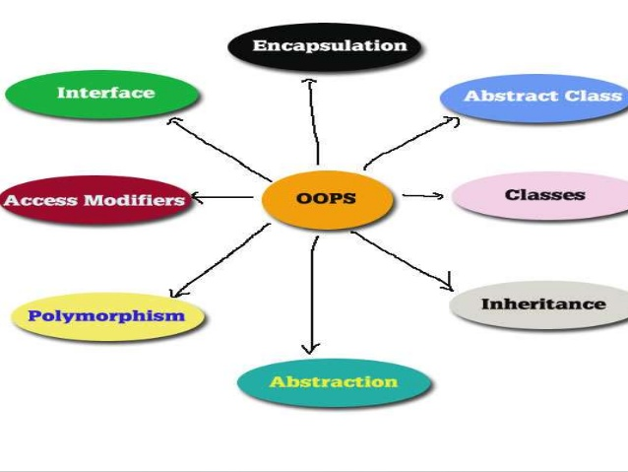
Object Oriented Programming & Design
Session – 4: 21-Oct-2018
Notes:
NOTE:
To change the image on this slide, select the picture and delete it. Then click the Pictures icon in the placeholder to insert your own image.

Slide 2

Agenda
Packages
  What
  Why
  How
Streams in Java
  What
  Why
  How

Slide 3
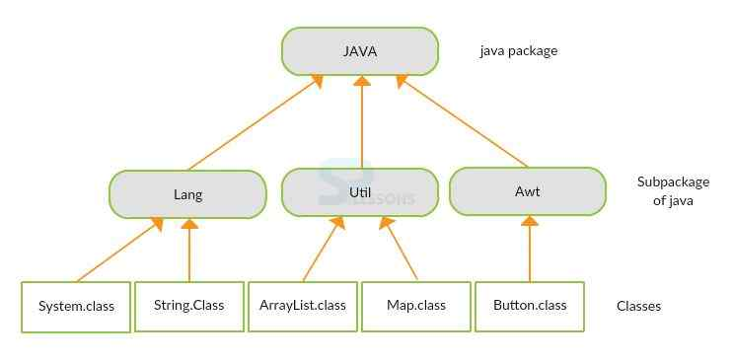
Java-Packages
Not your regular shopping package

Slide 4
Packages – Introduction – The What?.
A package as the name suggests is a pack(group) of classes, interfaces and other packages.
Each package in Java has its unique name and organizes its classes and interfaces into a separate namespace, or name group.
Packages are used for:
  Preventing naming conflicts. For example there can be two classes with name Employee in two packages, college.staff.cse.Employee and college.staff.ee.Employee
  Making searching/locating and usage of classes, interfaces, enumerations and annotations easier
  Providing controlled access: protected and default have package level access control. A protected member is accessible by classes in the same package and its subclasses. A default member (without any access specifier) is accessible by classes in the same package only.
Although interfaces and classes with the same name cannot appear in the same package, they can appear in different packages. This is possible by assigning a separate namespace to each package.
We can reuse existing classes from the packages as many time as we need it in our program

Slide 5
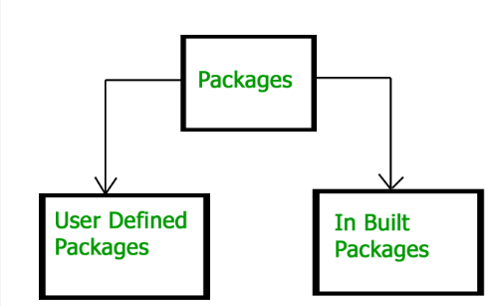
Packages – Introduction – Types?.
Built-in Packages
These packages consist of a large number of classes which are a part of Java API. Some of the commonly used built-in packages are:
  1) java.lang: Contains language support classes(e.g classed which defines primitive data types, math operations). This package is automatically imported.
  2) java.io: Contains classed for supporting input / output operations.
  3) java.util: Contains utility classes which implement data structures like Linked List, Dictionary and support ; for Date / Time operations.
  4) java.applet: Contains classes for creating Applets.
  5) java.awt: Contain classes for implementing the components for graphical user interfaces (like button , ;menus etc).
  6) java.net: Contain classes for supporting networking operations.

Slide 6
Packages – Introduction – Types?.
User-defined packages
These are the packages that are defined by the user.
First we create a directory myPackage (name should be same as the name of the package).
Then create the MyClass inside the directory with the first statement being the package names.

Slide 7
Packages – Introduction – The How?.
To make a Java package named pkg:
Make a directory named pkg. Put all the .java files for the classes and interfaces in the directory pkg.
Begin each of the .java files with a package declaration:
  package pkg;
Compile the files by running javac from pkg's parent directory. For example,
  javac pkg/*.java
Access the classes and interfaces of package pkg from other packages by importing its definitions with an import line in every .java file that uses them:
  import pkg;
Tell the Java interpreter how to find package pkg by putting pkg's parent directory on the classpath, or by running the interpreter from that directory.
If the full or relative pathname of pkg's parent directory is pname, then java -cp pname ... will put pname on the classpath and make package pkg accessible. If you have several packages in different parent directories, separate the names with colons: java -cp pname:name2:dir3 ....

Slide 8
Packages – Introduction – How?.
Each package in Java has its unique name and organizes its classes and interfaces into a separate namespace, or name group.
Package names and directory structure are closely related.
For example if a package name is college.staff.cse, then there are three directories, college, staff and cse such that cse is present in staff and staff is present college.
Also, the directory college is accessible through CLASSPATH variable, i.e., path of parent directory.
Package names are written in all lower case to avoid conflict with the names of classes or interfaces.

Slide 9
Packages – Introduction – How?.
Companies use their reversed Internet domain name to begin their package names — for example, com.example.mypackage for a package named mypackage created by a programmer at example.com.
Name collisions that occur within a single company need to be handled by convention within that company, perhaps by including the region or the project name after the company name (for example, com.example.region.mypackage).
Packages in the Java language itself begin with java. or javax.
In some cases, the internet domain name may not be a valid package name.
This can occur if the domain name contains a hyphen or other special character, if the package name begins with a digit or other character that is illegal to use as the beginning of a Java name, or if the package name contains a reserved Java keyword, such as "int". In this event, the suggested convention is to add an underscore.

Slide 10
Packages – Import.
To access a class or method from another package we need to use the fully qualified name or we can use import statements.
The class or method should also be accessible. Accessibility is based on the access modifiers.
Private members are accessible only within the same class.
So you won't be able to access a private member even with fully qualified name or an import statement.
But if you will have to use the fully qualified name every time you are accessing the class or the interface, which can look a little untidy if the package name is long.

Slide 11
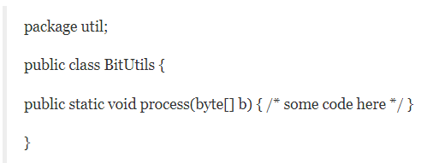
Packages – Import.
import keyword is used to import built-in and user-defined packages into your java source file so that your class can refer to a class that is in another package by directly using its name.
Remember that you can import only types (classes and interfaces, but not methods) using a regular import.
You can access the static method process from another package either as:
  util.BitUtils.process(bytes); ➔ Fully Qualified Name
or using an import statement and then use the class name without qualifier as:
  import util.BitUtils; ➔ Type Import
  ...
  BitUtils.process(bytes);

Slide 12
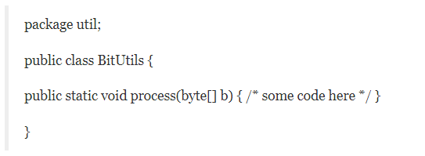
Packages – Static Import.
Regular import can import only types (classes and interfaces, but not methods).
Static imports can import a class's static members (variables and methods) as well.
Consider our BitUtils example again:
You can also use a static import as: import static util.BitUtils.process; and then simply use the process method as: process(bytes);
You can also use the fully qualified name and regular import here.
Another very common example is to use a static import for System.out.println as: import static java.lang.System.out;
And then using it as: out.println();
Even if the feature is called static import, syntax is import static.

Slide 13
Packages – Points on Import Statement
The import keyword is used to make the classes and interface of another package accessible to the current package
If you use packagename.*, then all the classes and interfaces of this package will be accessible but the classes and interface inside the sub-packages will not be available for use.
For example import java.util.*; import all of the classes in the java.util package, but not the java.util.jar classes or java.util.regex packages.
You cannot use a default access method from another package, as default members are not accessible outside the package.
Below packages from JDK are automatically imported into your code by Java:
  java.lang package
  default package (package with no name). However the use of default package is not a good practice.

Slide 14
Packages – Points on Import Statement
The class or method should also be accessible, even if we have the import statement or use a fully qualified name.
Accessibility is based on the access modifiers:
  Private members are accessible only within the same class.
  So you won't be able to access a private member even with fully qualified name or an import statement.
Classes within the same package can access each other without the import statement or a fully qualified name.
You can only import one package (i.e. all classes in that package) using a * or one class in an import statement. Following is an invalid import: import com.*.*

Slide 15
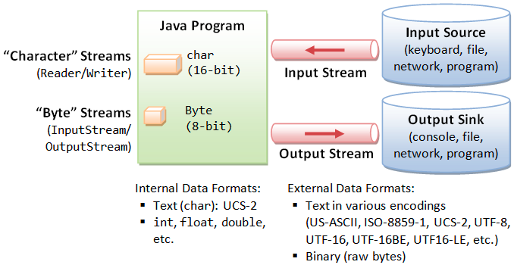
Java-Streams
Row, Row Row your I/P & O/P

Slide 16

Streams in Java
From the perspective of Java, "stream" essentially refers to an abstraction that is used to produce and consume flow of sequential information.
The flow of information can be a result of input or output operations performed on any physical device linked to Java I/O subsystem.
The actual linked devices may vary, such as a local storage device or network. But, the underlying principle remains the same.
Typically, Java stream supports a variety of devices, like a keyboard, network socket, disk file, and so forth. Hence, it provides a convenient way to handle I/O operation in the same way for different types of devices it is actually linked to.
The steam classes are bundled in the java.io package.

Slide 17
Streams in Java
There are two types of streams in Java: byte and character.
When an I/O stream manages 8-bit bytes of raw binary data, it is called a byte stream.
And, when the I/O stream manages 16-bit Unicode characters, it is called a character stream.
A Unicode set is basically a type of character set where each character corresponds to a specific numeric value within the given character set.
Typically, every programming language adopts a particular character set to represent and manage its use of characters.
Apart from Unicode, another commonly used character set is ASCII, defined by the International Standard Organization (ISO).
At the inception of Java (version 1.0), it did not have character streams; therefore, all I/O operations were byte oriented.
The character streams were introduced later (version 1.1).
Note that the idea of character and byte streams should not be mixed with low-level I/O operation; they are always bit and bytes, after all.
But, the point of character and byte streams essentially provides a convenient and efficient way to handle data streams in Java.

Slide 18
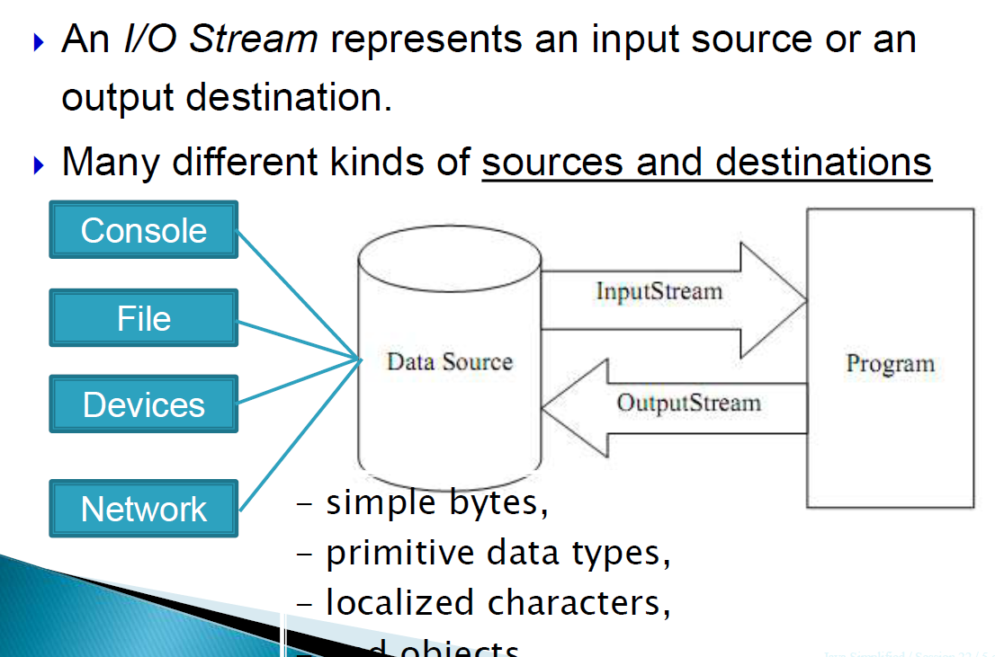
I/O : Streams
an abstraction that either produces or consumes information.
➢ linked to a physical device by the Java I/O system.
➢ All streams behave in the same manner, even if the actual physical devices to which they are linked differ.
➢ Clean way to deal with i/o without having every part of your code understand the difference between a keyboard and a network

Slide 19
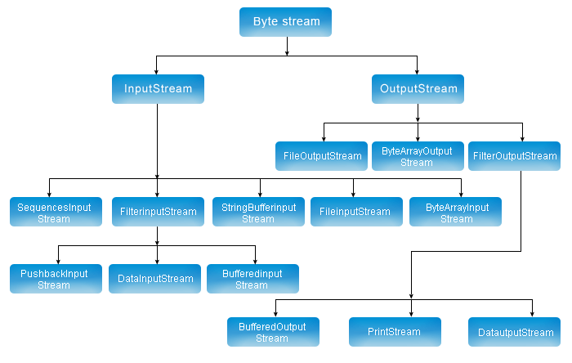
Byte Streams
At the top of the byte stream class hierarchy, there are two abstract classes:
  InputStream for byte-oriented input and
  OutputStream for byte-oriented output operations. The hierarchical layout is as follows:
Java byte streams are used to perform input and output of 8-bit bytes.
Though there are many classes related to byte streams but the most frequently used classes are, FileInputStream and FileOutputStream.
Notes:
As mentioned earlier, the difference is simply for convenience.
Some streams are inherently byte oriented and some are character oriented.
As a result, it is always convenient to handle them with appropriate classes and methods defined in I/O stream package.
For example, the FileInputStream is meant for reading a raw stream of bytes, such as image data.
Similarly, the FileOutputStream object may be used to write a raw byte stream.
Under similar circumstances, reading and writing files based on character-oriented stream of data FileReader and FileWriter may be used, respectively.
These classes provide specific methods to manipulate appropriate stream data.

Slide 20
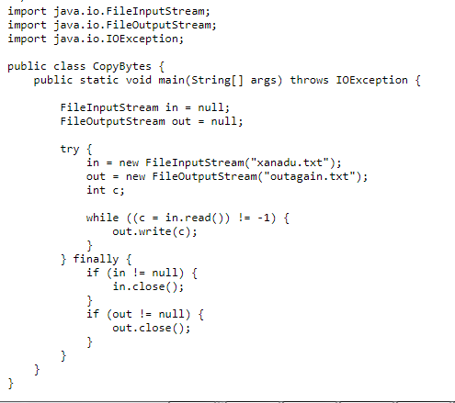
Byte Stream - Examples
Programs use byte streams to perform input and output of 8-bit bytes.
All byte stream classes are descended from InputStream and OutputStream.
There are many byte stream classes.
To demonstrate how byte streams work, we'll focus on the file I/O byte streams, FileInputStream and FileOutputStream. Other kinds of byte streams are used in much the same way; they differ mainly in the way they are constructed.
Notes:
As mentioned earlier, the difference is simply for convenience.
Some streams are inherently byte oriented and some are character oriented.
As a result, it is always convenient to handle them with appropriate classes and methods defined in I/O stream package.
For example, the FileInputStream is meant for reading a raw stream of bytes, such as image data.
Similarly, the FileOutputStream object may be used to write a raw byte stream.
Under similar circumstances, reading and writing files based on character-oriented stream of data FileReader and FileWriter may be used, respectively.
These classes provide specific methods to manipulate appropriate stream data.

Slide 21
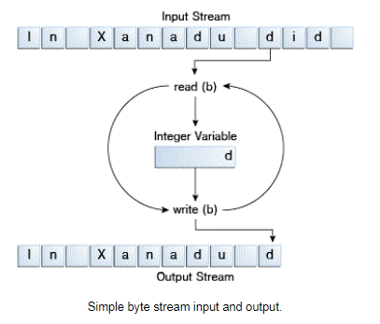
Byte Stream - Examples
CopyBytes spends most of its time in a simple loop that reads the input stream and writes the output stream, one byte at a time, as shown in the following figure.
Notes:
As mentioned earlier, the difference is simply for convenience.
Some streams are inherently byte oriented and some are character oriented.
As a result, it is always convenient to handle them with appropriate classes and methods defined in I/O stream package.
For example, the FileInputStream is meant for reading a raw stream of bytes, such as image data.
Similarly, the FileOutputStream object may be used to write a raw byte stream.
Under similar circumstances, reading and writing files based on character-oriented stream of data FileReader and FileWriter may be used, respectively.
These classes provide specific methods to manipulate appropriate stream data.

Slide 22
Byte Stream - Examples
Always Close Streams
Closing a stream when it's no longer needed is very important — so important that CopyBytes uses a finally block to guarantee that both streams will be closed even if an error occurs. This practice helps avoid serious resource leaks.
One possible error is that CopyBytes was unable to open one or both files. When that happens, the stream variable corresponding to the file never changes from its initial null value. That's why CopyBytes makes sure that each stream variable contains an object reference before invoking close.
When Not to Use Byte Streams
CopyBytes seems like a normal program, but it actually represents a kind of low-level I/O that you should avoid. Since xanadu.txt contains character data, the best approach is to use character streams, as discussed in the next section. There are also streams for more complicated data types. Byte streams should only be used for the most primitive I/O.
So why talk about byte streams? Because all other stream types are built on byte streams.
Notes:
As mentioned earlier, the difference is simply for convenience.
Some streams are inherently byte oriented and some are character oriented.
As a result, it is always convenient to handle them with appropriate classes and methods defined in I/O stream package.
For example, the FileInputStream is meant for reading a raw stream of bytes, such as image data.
Similarly, the FileOutputStream object may be used to write a raw byte stream.
Under similar circumstances, reading and writing files based on character-oriented stream of data FileReader and FileWriter may be used, respectively.
These classes provide specific methods to manipulate appropriate stream data.

Slide 23
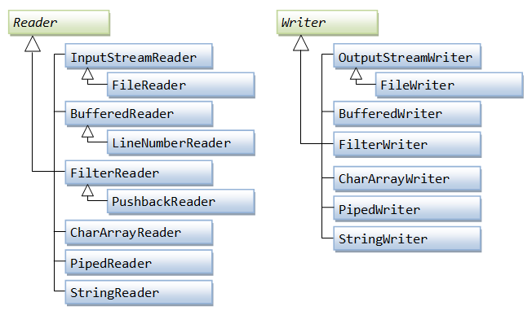
Character Streams
At the top of the character stream class hierarchy, there are two abstract classes:
  Reader for character-oriented input and
  Writer for character-oriented output operations. The hierarchical layout is as follows:
The Java platform stores character values using Unicode conventions.
Character stream I/O automatically translates this internal format to and from the local character set.
In Western locales, the local character set is usually an 8-bit superset of ASCII.
For most applications, I/O with character streams is no more complicated than I/O with byte streams.
Input and output done with stream classes automatically translates to and from the local character set.

Slide 24
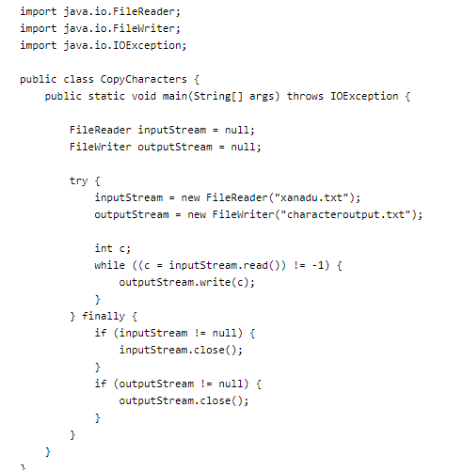
Character Stream - Examples
All character stream classes are descended from Reader and Writer.
As with byte streams, there are character stream classes that specialize in file I/O: FileReader and FileWriter.
CopyCharacters is very similar to CopyBytes. The most important difference is that CopyCharacters uses FileReader and FileWriter for input and output in place of FileInputStream and FileOutputStream.
Notice that both CopyBytes and CopyCharacters use an int variable to read to and write from. However, in CopyCharacters, the int variable holds a character value in its last 16 bits; in CopyBytes, the int variable holds a byte value in its last 8 bits.
Notes:
As mentioned earlier, the difference is simply for convenience.
Some streams are inherently byte oriented and some are character oriented.
As a result, it is always convenient to handle them with appropriate classes and methods defined in I/O stream package.
For example, the FileInputStream is meant for reading a raw stream of bytes, such as image data.
Similarly, the FileOutputStream object may be used to write a raw byte stream.
Under similar circumstances, reading and writing files based on character-oriented stream of data FileReader and FileWriter may be used, respectively.
These classes provide specific methods to manipulate appropriate stream data.

Slide 25
Character Stream - Examples
Character Streams that Use Byte Streams
Character streams are often "wrappers" for byte streams.
The character stream uses the byte stream to perform the physical I/O, while the character stream handles translation between characters and bytes.
FileReader, for example, uses FileInputStream, while FileWriter uses FileOutputStream.
There are two general-purpose byte-to-character "bridge" streams: InputStreamReader and OutputStreamWriter.
‘Use them to create character streams when there are no prepackaged character stream classes that meet your needs.
Notes:
The sockets lesson in the networking trail shows how to create character streams from the byte streams provided by socket classes.

Slide 26
Buffered Stream
Most of the examples we've seen so far use unbuffered I/O. This means each read or write request is handled directly by the underlying OS.
This can make a program much less efficient, since each such request often triggers disk access, network activity, or some other operation that is relatively expensive.
To reduce this kind of overhead, the Java platform implements buffered I/O streams.
Buffered input streams read data from a memory area known as a buffer; the native input API is called only when the buffer is empty.
Similarly, buffered output streams write data to a buffer, and the native output API is called only when the buffer is full.
A program can convert an unbuffered stream into a buffered stream using the wrapping idiom we've used several times now, where the unbuffered stream object is passed to the constructor for a buffered stream class.
  inputStream = new BufferedReader(new FileReader("xanadu.txt"));
  outputStream = new BufferedWriter(new FileWriter("characteroutput.txt"));
There are four buffered stream classes used to wrap unbuffered Streams: BufferedInputStream and BufferedOutputStream create buffered byte streams, while BufferedReader andBufferedWriter create buffered character streams.

Slide 27
Buffered Stream
Flushing Buffered Streams
It often makes sense to write out a buffer at critical points, without waiting for it to fill. This is known as flushing the buffer.
Some buffered output classes support autoflush, specified by an optional constructor argument.
When autoflush is enabled, certain key events cause the buffer to be flushed.
For example, an autoflush PrintWriter object flushes the buffer on every invocation of println or format.
To flush a stream manually, invoke its flush method. The flush method is valid on any output stream, but has no effect unless the stream is buffered.

Slide 28
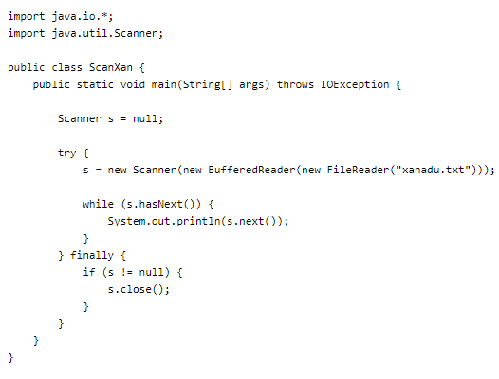
Scanning & Formatting
Programming I/O often involves translating to and from the neatly formatted data humans like to work with.
To assist you with these chores, the Java platform provides two APIs.
The scanner API breaks input into individual tokens associated with bits of data.
Objects of type Scanner are useful for breaking down formatted input into tokens and translating individual tokens according to their data type.
Breaking Input into Tokens
By default, a scanner uses white space to separate tokens. (White space characters include blanks, tabs, and line terminators. For the full list, refer to the documentation forCharacter.is Whitespace.)
Notice that ScanXan invokes Scanner's close method when it is done with the scanner object. Even though a scanner is not a stream, you need to close it to indicate that you're done with its underlying stream.

Slide 29
Scanning & Formatting
To use a different token separator, invoke useDelimiter(), specifying a regular expression.
For example, suppose you wanted the token separator to be a comma, optionally followed by white space.
You would invoke, s.useDelimiter(",\\s*");
The ScanXan example treats all input tokens as simple String values. Scanner also supports tokens for all of the Java language's primitive types (except for char), as well as BigInteger and BigDecimal.
Also, numeric values can use thousands separators. Thus, in a US locale, Scanner correctly reads the string "32,767" as representing an integer value.
We have to mention the locale, because thousands separators and decimal symbols are locale specific. So, the following example would not work correctly in all locales if we didn't specify that the scanner should use the US locale.

Slide 30
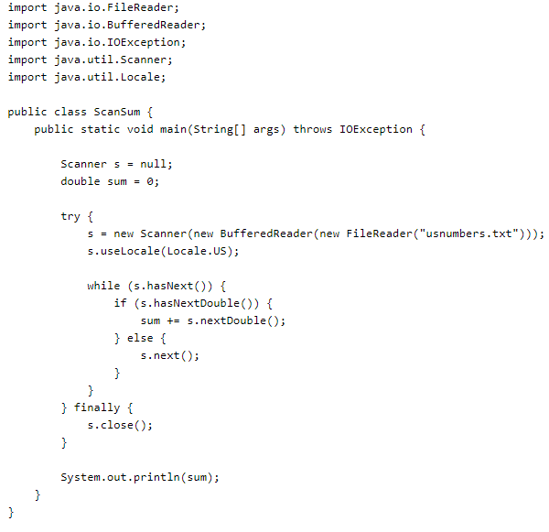
Scanner Example

Slide 31
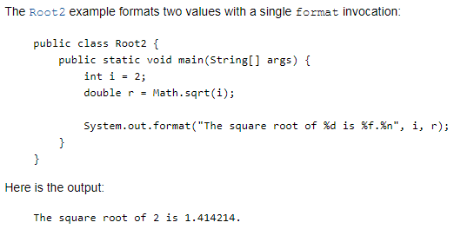
Scanning & Formatting
The format method formats multiple arguments based on a format string.
The format string consists of static text embedded with format specifiers; except for the format specifiers, the format string is output unchanged.
Like the three used in this example, all format specifiers begin with a % and end with a 1- or 2-character conversion that specifies the kind of formatted output being generated.
The three conversions used here are:
  d formats an integer value as a decimal value.
  f formats a floating point value as a decimal value.
  n outputs a platform-specific line terminator.
Here are some other conversions:
x formats an integer as a hexadecimal value.
s formats any value as a string.
tB formats an integer as a locale-specific month name.
Notes:
https://docs.oracle.com/javase/8/docs/api/java/util/Formatter.html#syntax

Slide 32
Scanning & Formatting
The format method formats multiple arguments based on a format string.
The format string consists of static text embedded with format specifiers; except for the format specifiers, the format string is output unchanged.
Like the three used in this example, all format specifiers begin with a % and end with a 1- or 2-character conversion that specifies the kind of formatted output being generated.
The three conversions used here are:
  d formats an integer value as a decimal value.
  f formats a floating point value as a decimal value.
  n outputs a platform-specific line terminator.
Here are some other conversions:
x formats an integer as a hexadecimal value.
s formats any value as a string.
tB formats an integer as a locale-specific month name.
Notes:
https://docs.oracle.com/javase/8/docs/api/java/util/Formatter.html#syntax

Slide 33
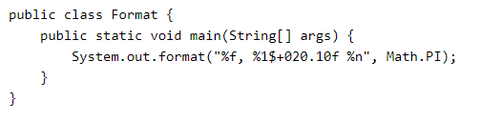
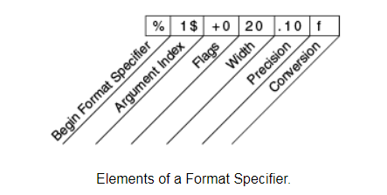
Scanning & Formatting
In addition to the conversion, a format specifier can contain several additional elements that further customize the formatted output. The elements must appear in the order shown. Working from the right, the optional elements are:
Precision. For floating point values, this is the mathematical precision of the formatted value. For s and other general conversions, this is the maximum width of the formatted value; the value is right-truncated if necessary.
Width. The minimum width of the formatted value; the value is padded if necessary. By default the value is left-padded with blanks.
Flags specify additional formatting options. In the Format example, the + flag specifies that the number should always be formatted with a sign, and the 0 flag specifies that 0 is the padding character. Other flags include - (pad on the right) and , (format number with locale-specific thousands separators). Note that some flags cannot be used with certain other flags or with certain conversions.
The Argument Index allows you to explicitly match a designated argument. You can also specify < to match the same argument as the previous specifier. Thus the example could have said: System.out.format("%f, %<+020.10f %n", Math.PI);
Notes:
https://docs.oracle.com/javase/8/docs/api/java/util/Formatter.html#syntax

Slide 34
Java-File OPS
Row, Row Row your I/P & O/P

Slide 35
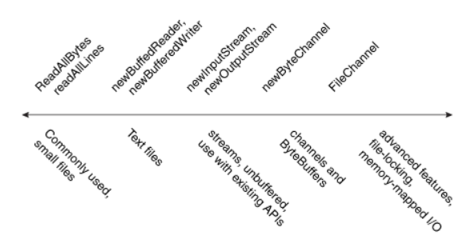
Files I/O in Java
There are a wide array of file I/O methods to choose from. To help make sense of the API, the following diagram arranges the file I/O methods by complexity
On the far left of the diagram are the utility methods
readAllBytes, readAllLines, and the write methods, designed for simple, common cases.
newBufferedReader, newBufferedWriter The methods used to iterate over a stream or lines of text
newInputStream and newOutputStream These methods are interoperable with the java.io package.
newByteChannel method for dealing with ByteChannels, SeekableByteChannels, and ByteBuffers
Finally, on the far right are the methods that use FileChannel for advanced applications needing file locking or memory-mapped I/O.
Notes:
https://docs.oracle.com/javase/8/docs/api/java/util/Formatter.html#syntax

Slide 36
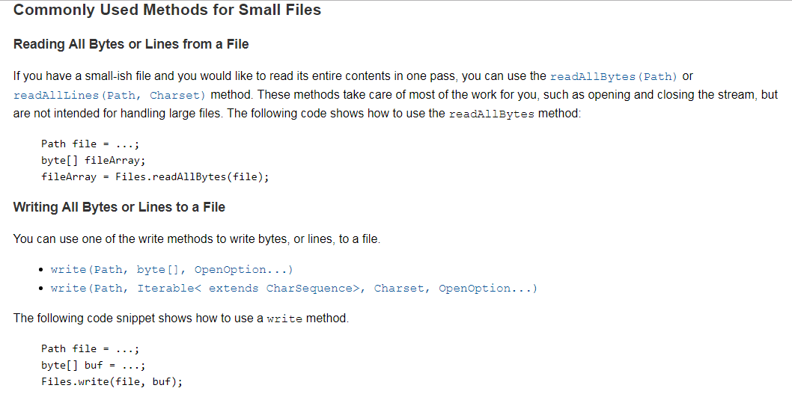
Files I/O in Java
Notes:
https://docs.oracle.com/javase/8/docs/api/java/util/Formatter.html#syntax

Slide 37
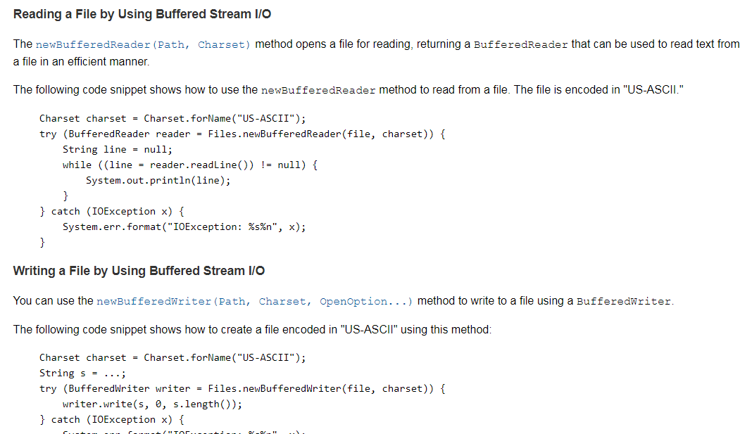
Files I/O in Java
Notes:
https://docs.oracle.com/javase/8/docs/api/java/util/Formatter.html#syntax

Slide 38

Questions ?
You can contact me @
avadekkedhil@wilp.bits-pilani.ac.in
9881300394

